Slide 1
No | PARTNO | PARTNAME | STATUS | CHECKING TIME | OK | NG | REASON
1 | QC7-4753 (PARTOK_04) | SIDE COVER | OK | 10 | 10 | 10
2 | QC7-4753 (PARTOK_01) | SIDE COVER | OK | 10 | 3 | 7 | 1. POSITION CHANGE --> BINARY INDEX CHANGE, 2. FRAME 84, IMAGE BINARY AVERAGE CHANGE 8BIT
3 | QC7-4754 (PARTOK_02) | SIDE COVER | OK | 10 | 10 | 0
4 | QC7-4754 (PARTOK_03) | SIDE COVER | OK | 10 | 7 | 3 | 1. FRAME 86, IMAGE BINARY AVERAGE CHANGE 7BIT 2. FRAME 76, IMAGE BINARY AVERAGE CHANGE 7BIT 3. POSITION CHANGE --> BINARY INDEX CHANGE,
SAMPLE

Slide 2
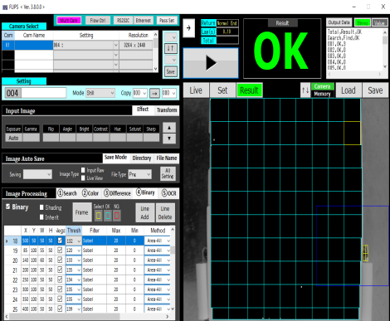
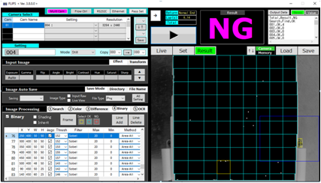
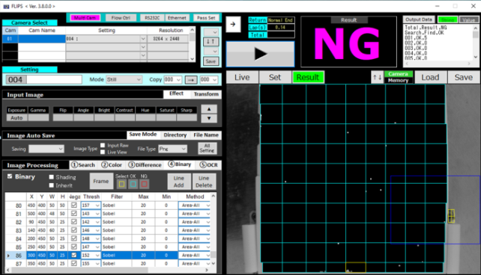

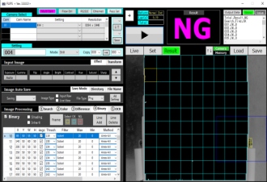
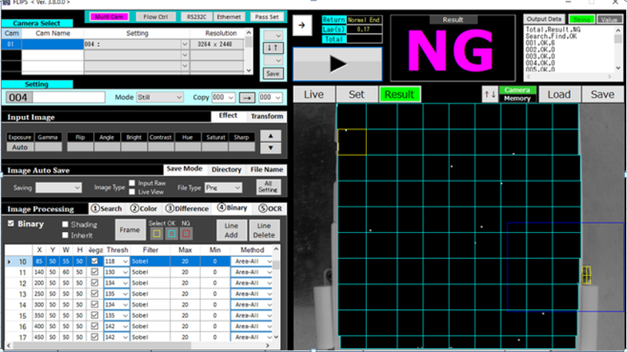
IMG1,3
IMG2
IMG4

Slide 3
No | PARTNO | PARTNAME | STATUS | CHECKING TIME | OK | NG | REASON
5 | QC7-4753 (PARTOK_05) | SIDE COVER | OK | 10 | 10 | 10
6 | QC7-4753 (PARTOK_06) | SIDE COVER | OK | 10 | 8 | 2 | 1. POSITION CHANGE --> BINARY INDEX CHANGE, 2. FRAME 21, IMAGE BINARY AVERAGE CHANGE 5BIT
7 | QC7-4754 (PARTOK_07) | SIDE COVER | OK | 10 | 8 | 2 | 1. POSITION CHANGE --> BINARY INDEX CHANGE,
8 | QC7-4754 (PARTOK_08) | SIDE COVER | OK | 10 | 9 | 1 | 1. FRAME 28, IMAGE BINARY AVERAGE CHANGE 3BIT

Slide 4
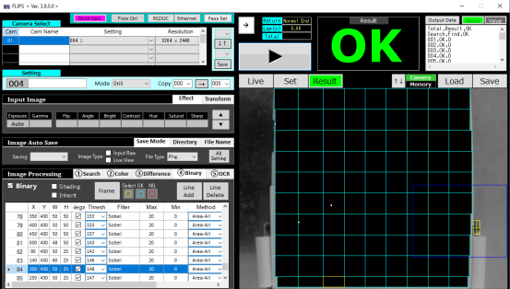
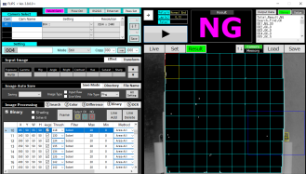
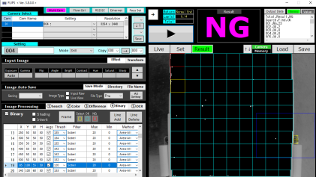
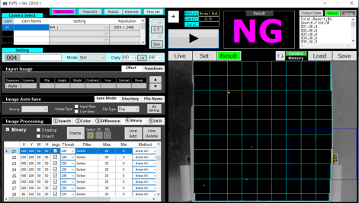
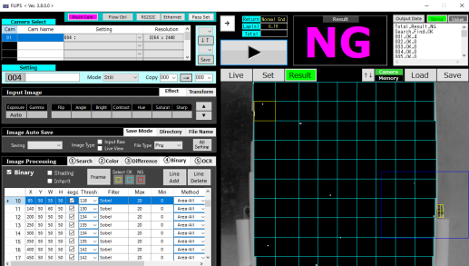
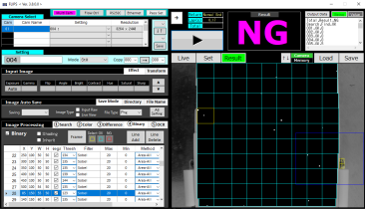
IMG5
IMG7
IMG6
IMG8

Slide 5
No | PARTNO | PARTNAME | STATUS | CHECKING TIME | OK | NG | REASON
9 | QC7-4753 (PARTOK_09) | SIDE COVER | OK | 10 | 9 | 1 | 1. POSITION CHANGE --> BINARY INDEX CHANGE,
10 | QC7-4753 (PARTOK_10) | SIDE COVER | OK | 10 | 8 | 2 | 1. POSITION CHANGE --> BINARY INDEX CHANGE, 2. FRAME 21, IMAGE BINARY AVERAGE CHANGE 5BIT
11 | QC7-4754 (PARTOK_11) | SIDE COVER | OK | 10 | 10 | 0
12 | QC7-4754 (PARTOK_12) | SIDE COVER | OK | 10 | 10 | 0

Slide 6

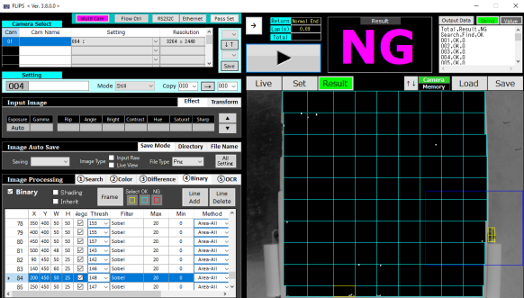

IMG9
IMG10

Slide 7
No | PARTNO | PARTNAME | STATUS | CHECKING TIME | OK | NG | REASON
13 | QC7-4753 (PARTOK_13) | SIDE COVER | OK | 10 | 5 | 5 | 1. FRAME 76, IMAGE BINARY AVERAGE CHANGE 8BIT
14 | QC7-4753 (PARTOK_14) | SIDE COVER | OK | 10 | 10 | 0
15 | QC7-4754 (PARTOK_15) | SIDE COVER | OK | 10 | 10 | 0
16 | QC7-4754 (PARTOK_16) | SIDE COVER | OK | 10 | 2 | 8 | Dust Average binary at OK reduce → Failed call

Slide 8


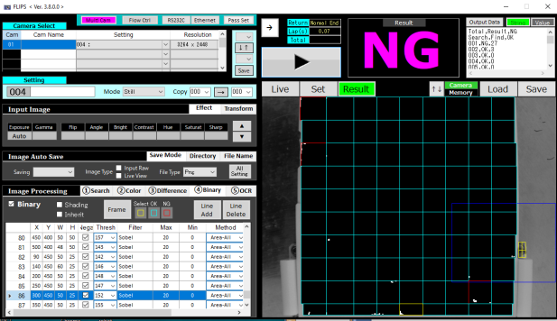

IMG13
IMG16

Slide 9
No | PARTNO | PARTNAME | STATUS | CHECKING TIME | OK | NG | REASON
17 | QC7-4753 (PARTOK_17) | SIDE COVER | OK | 10 | 10 | 0
18 | QC7-4753 (PARTOK_18) | SIDE COVER | OK | 10 | 2 | 8 | 1. FRAME 86,84,76, IMAGE BINARY AVERAGE CHANGE 8BIT
19 | QC7-4754 (PARTOK_19) | SIDE COVER | OK | 10 | 9 | 1 | 1. Dust
20 | QC7-4754 (PARTOK_20) | SIDE COVER | OK | 10 | 7 | 3 | 1. FRAME 86,84,76, IMAGE BINARY AVERAGE CHANGE 8BIT

Slide 10

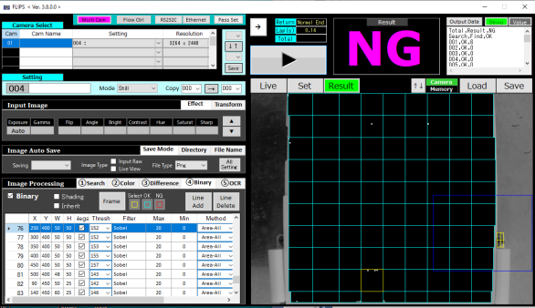

IMG18
IMG20
IMG19

Slide 11
No | PARTNO | PARTNAME | STATUS | CHECKING TIME | OK | NG | REASON
21 | QC7-4753 (PARTOK_21) | SIDE COVER | OK | 10 | 10 | 0
22 | QC7-4753 (PARTOK_22) | SIDE COVER | OK | 10 | 10 | 0
23 | QC7-4754 (PARTOK_23) | SIDE COVER | OK | 10 | 2 | 8 | 1. Position failed
24 | QC7-4754 (PARTOK_24) | SIDE COVER | OK | 10 | 5 | 5 | 1. FRAME 86,84,76, IMAGE BINARY AVERAGE CHANGE 5BIT
25 | QC7-4754 (PARTOK_25) | SIDE COVER | OK | 10 | 6 | 4 | 1. FRAME 86,84,76, IMAGE BINARY AVERAGE CHANGE 6 BIT

Slide 12

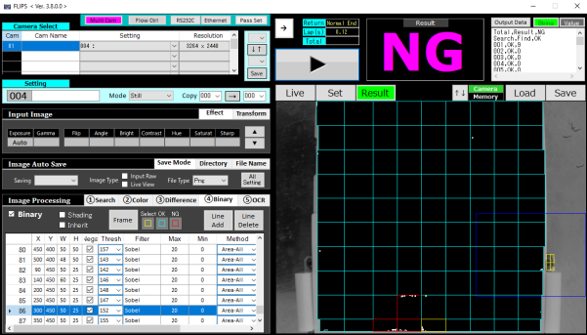

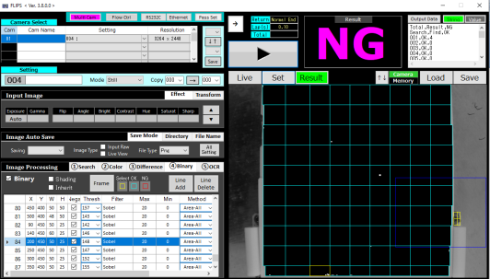
IMG23
IMG25
IMG24

Slide 13
No | PARTNO | PARTNAME | STATUS | CHECKING TIME | OK | NG | REASON
26 | QC7-4753 (PARTOK_26) | SIDE COVER | OK | 10 | 10 | 0
27 | QC7-4753 (PARTOK_27) | SIDE COVER | OK | 10 | 10 | 0
28 | QC7-4754 (PARTOK_28) | SIDE COVER | OK | 10 | 10 | 0

Slide 14
No | PARTNO | PARTNAME | STATUS | CHECKING TIME | OK | NG | REASON
1 | QC7-4753 (PARTOK_1) | SIDE COVER | NG | 10 | 10 | 0
2 | QC7-4753 (PARTOK_2) | SIDE COVER | NG | 10 | 0 | 10 | 1. Ng POINT too small, can not check with spec 0-20 binany
3 | QC7-4754 (PARTOK_3) | SIDE COVER | NG | 10 | 2 | 8 | 1. Ng POINT too small, can not check with spec 0-20 binany
4 | QC7-4754 (PARTOK_4) | SIDE COVER | NG | 10 | 10 | 0
5 | QC7-4754 (PARTOK_5) | SIDE COVER | NG | 10 | 10 | 0

Slide 15
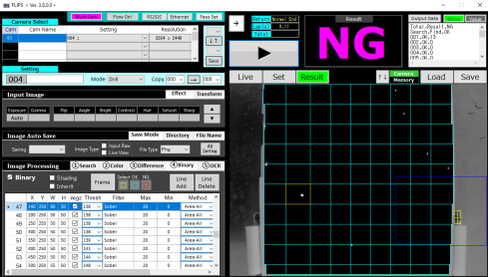
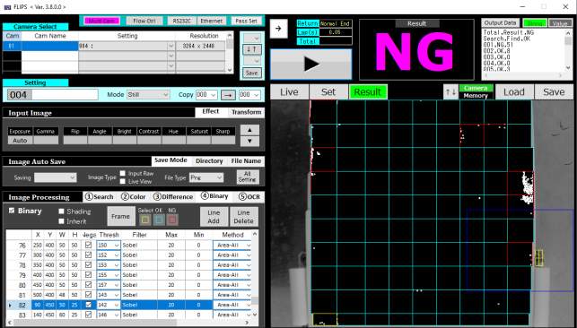
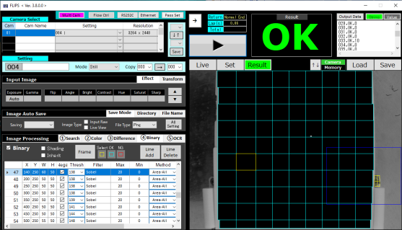
IMG_ng01
IMG_ng04
IMG_ng03

